Slide 1

Bitmex Rekt
Igor Egin

Slide 2
Overview and Origin
Bitmex was incorporated in 2014.
It is owned by HDR Global Trading Limited and is registered in the Seychelles Islands.
Founded by Arthur Hayes, Ben Delo, and Samuel Reed
The company was funded by money from friends and family.

Slide 3
Big Idea
“What I saw was a transition point in how people deal with money and this usually happens in our society every, you know two or three hundred years. So we are moving along society in terms of money transfer to a digital one that’s going to be hugely disruptive and I saw a chance with bitcoin and crypto to actually create a company that could benefit from this hugely chaotic transformation.” Arthur Hayes

Slide 4
Business Activiteis
Global access to financial instruments and credit.
Utilizing bitcoin as a tool to circumvent regulations like KYC and gain access to broader market.
All exchange operations are handled through the same API on mobile, desktop, and even institutional clients have equal access to the platform through OpenAPI.
100% cold storage and 2 of 3 multisig
‘Order Shedding’ to reduce temporary overload.

Slide 5
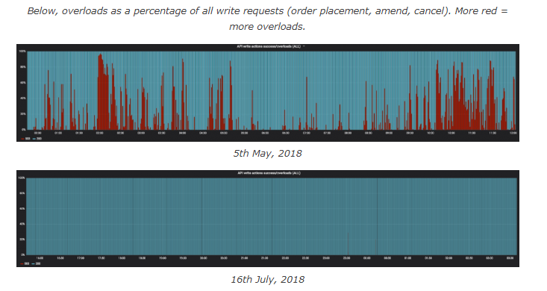
Performance Upgrades
Kdb+ is a proprietary database commonly used in high-frequency trading to store, analyze and retrieve large data sets at high speed. In May 2018 Bitmex optimized its trading engine with kdb+ and improved its performance by 4.6x in the first 30 days and 10x by the end of August.

Slide 6
Landscape
0 – 1 The cryptocurrency industry has grown from cypherpunks with an idea to a robust niche market.
Scaling problems difficult to overcome with rapid frenzied expansions.
Market leaders tend to shift during times of high growth and can maintain it if they find their strength.
Leverage
Altcoins
No KYC

Slide 7
Results
Industry standard in high leverage bitcoin futures.
High trust for lack of account balance errors and no user funds lost to hackers.
Massive 30k BTC insurance fund that allows for protection against
Automatic Deleveraging
Socialized losses on hedged or outright positions

Slide 8
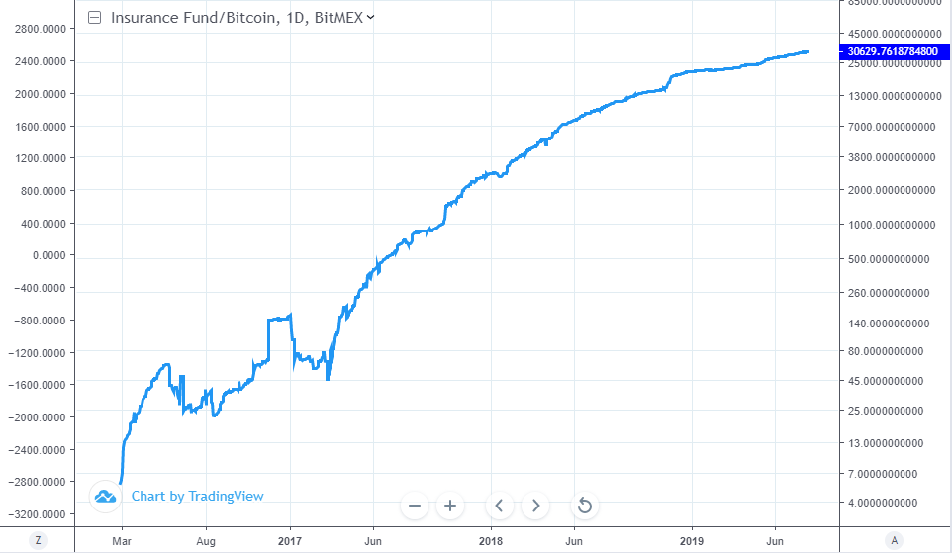
Bitmex Insurance Fund in BTC

Slide 9
Recomendations
Options are a confirmed and obvious but necessary route if Bitmex wants to stay in the lead of big regulated players like LedgerX
Custom financial indices of developing markets to give people more financial tools.
Bitmex has already announced that it is planning on rolling out zero coupon bitcoin bonds to allow users to earn interest on their bitcoin by giving short term loans to large crypto companies. This is an entirely new market and instrument that they are opening up and pricing that retail traders have not had access to. This might become one of the first big attempts at bitcoin interest bearing accounts and may change the way people perceive holding bitcoin or holding bitcoin on an exchange.

